Slide 1
QA Foundational Improvements – Phase III Steering Committee Update
Quality Engineering
October 25, 2019
V2.0 02.14.2018

Slide 2
Agenda
1
Initiative Charter, Key Capabilities, Roadmap
2
Key Accomplishments
3
Initiative & Financial Health Assessment
4
Major Issues & Risks
5
Key Next Steps & Leadership Asks
6
Appendix
Key Asks/Decisions Needed From Working Group:
Progress Awareness
Team Maturity & Utilizing Best Practices
Input on overall project direction.

Slide 3
Initiative Charter, Key Capabilities & Outcomes
Charter:
Our objective is to provide tools and solutions for automation and testing that enable delivery of high-quality solutions to our Business Partners & Customers:
Scalable Approach - improve the efficiency of testing with methodologies that enable issue detection and prevention.
Modernized framework, tools, and processes that increase the development and use of automation.
Key Capabilities & Outcomes:
Testing and Automation CoE fully integrated with SDLC Methodology
Governance Committee:
Operating model for testing, processes, and roles & responsibilities.
Training for all testing roles in technology.
Coaching on new processes and technology.
Scalable testing methodologies.
Automation Frameworks to support Shift Left and CI/CD.
System quality and dependability
Early issue detection
Issue Prevention
Create Quality & Testing Center of Excellence for
Functional IT and Business Testing
Automation
Performance, Load, and Stress Testing

Slide 4


Program Roadmap
Phase III: Lift and Scale for SAFe & Non-SAFe Teams--In Progress
2018 |  |  |  |  |  |  |  |  |  |  |  | 2019
Q1 |  |  | Q2 |  |  | Q3 |  |  | Q4 |  |  | Q1 |  |  | Q2 |  |  | Q3 |  |  | Q4
Jan | Feb | Mar | Apr | May | Jun | Jul | Aug | Sep | Oct | Nov | Dec | Jan | Feb | Mar | Apr | May | Jun | Jul | Aug | Sep | Oct | Nov | Dec
Q1 ’18 |  |  | Q2 ‘18 |  |  | Q3 ’18 |  |  | Q4 ‘18 |  |  | Q1 ‘19 |  |  | Q2 ‘19 |  |  | Q3 ‘19 |  |  | Q4 ‘19
Internal assessment Automation framework Test Artifact & metric standardization |  |  | Identify Quality partner |  |  | Publish assessment improvement recommendations |  |  | Test Case standards. Test Management Tool Evaluation. Metric requirements. Automation Framework. |  |  | Defect Standards. Quality Metrics Coverage & traceability. Test artifacts. Automation framework rollout. Plan Phase III – Lift & Scale |  |  | Lift & Scale SAFe Rollout foundational tools and processes to ART 1. Scale artifacts to Waterfall and Hybrid. |  |  | Lift & Scale SAFe ART 1 & ART2 PI3 ART2 Standardized, repeatable, consistent, best in practice QE processes Centralized, scalable automation framework |  |  | Lift & Scale SAFe PI3 ART2 PI4 ART1 New Team-Standardized, repeatable, consistent, best in practice QE processes New Team - Centralized, scalable automation framework
Internal Assessment & Partner Selection
Complete
Planning
Phase I – Assess, Prioritize, Roadmap
Execution
Complete
Phase II – Foundational Improvements
Complete
Automation Start
Phase III – Lift & Scale
In-Flight
Maturity Progression:
DEVELOPING
DEFINED
Major Capabilities

Slide 5
Player/Coach High Level Rollout Plan – PI3
Sprint 1
Sprint 2
Sprint 3
Sprint 4
Sprint 5
Sprint 6
PI 4
ART 2 SAFe ~ 4 weeks
Traceability
Test case and defect standardization
Test prioritization
Test Case Maintenance
Test Management tool use
ART 2 SAFe ~ 4 weeks
Test Management tool training/ documentation
QE reporting process/tools
ART 2 SAFe ~ 4 weeks
Automation Tool ecosystem
Automation Traceability
Automation estimation/tracking/maintenance
ART 2 SAFe ~ 4 weeks
Automation deployment integration
Automation process to identify test failure vs application failure
Code quality/standards/reviews
Legend
QE Lead
Automation Architect
Phase I
Phase II
On-going governance, training, retrospectives, collection of test metrics
ART1 – 100%
ART2 – 100%
PI3 ART2– 100%
ART1 – 100%
ART2 – 100%
PI3 ART2– 80%

Slide 6
Progress Updates on Reaching Level 3 Maturity by 12.31.19
Team | Level 3 By 12/31/19
ART 1
E&B
Sales Platform
Provider Directory
Marketplace
ESS
ART 2 – PI2
Group Member Management Online
Group Member Management Batch
Provider Management
Provider Experience
Common Challenges:
Staffing
Resource/Capacity (QE/Automation)
Dual role responsibilities
Consistency practicing and adopting best practices and including it as part of sprint estimations (touch base meetings)
Other
Increased application ownership
Data/Environment
Legend
GREEN – Ability to get to Maturity level 3 by EOY
YELLOW – May not reach Maturity level 3 by EOY

Slide 7
Change Management Progress Assessment as of 10.18.19
Categories | Aware of the QA Improvement Project Changes? | Willing to Make the Changes Related to the QA Improvement Project? | Have Been Trained/Coached on the Changes? | Are There Gaps in Following Best Practices & Standards? (Type of Issue) |  |  | Have Received Positive Recognition for Making the Change?
 |  |  |  | Manual | Automation
ART 1 Teams
Enrollment & Billing |  |  |  |  | Minimal/No Progress (Resource) | Minimal/No Progress (Resource)
Sales Platform |  |  |  |  | Minimal/No Progress (Resource) | Minimal/No Progress (Resource)
Provider Directory
Marketplace
ESS |  |  |  | Test Planning and Traceability (Process)
ART 2 Teams PI2
GMM--Online |  |  |  | Test Case Review (Process) | Minimal Progress (Resource) | Minimal Progress (Resource)
GMM--Batch |  |  |  | Test Case Review (Process/Resource) | Minimal/No Progress (Resource) | Minimal/No Progress (Resource)
Provider Management |  |  |  | Test Planning, Defects, and Traceability (Resource) | Minimal Progress (Resource) | Minimal Progress (Resource)
Provider Experience |  |  |  | Test Planning, Defects, and Traceability. (Resource)

Slide 8
Change Management Progress Assessment as of 10.18.19
Categories | Aware of the QA Improvement Project Changes? | Willing to Make the Changes Related to the QA Improvement Project? | Have Been Trained/Coached on the Changes? | Are There Gaps in Following Best Practices & Standards? (Type of Issue) |  | Have Received Positive Recognition for Making the Change?
 |  |  |  | Manual | Automation
ART 2 Teams PI3 -- Ongoing Coaching
EIVR |  |  |  |  | Pilot in Progress (Resource)
EBD & EP |  |  |  | Test Planning, Defects, and Traceability (Resource) | Pilot in Progress (Resource)
Document Management |  |  |  | Creating Defects (Process) | Tool Evaluation in Progress (Resource)
Group Billing Management |  |  |  | Test Case Review (Process/Resource) | Pilot in Progress
Customer Onboarding |  |  |  |  | Onboarding New Resource
CRM Growth |  |  |  |  | Onboarding New Resource

Slide 9

Key Accomplishments and Activities
Capabilities: Standards / Methodology / Process
KEY ACCOMPLISHMENTS – since 9/30
PI3 - ART2 – Phase I 100% / Phase II 80% Completed Phase I – testing basics; process, tools, traceability, automation framework. Starting Phase II – metrics/reporting, code quality standards, automation design. ART1 & ART2 – Ongoing Check-ins after Coaching Completed Completed Phase I – testing basics; process, tools, traceability, automation framework. Completed Phase II – metrics/reporting, code quality standards, automation design. Kicked off End-to-End Test Planning with Product Owners & Managers Publish baseline state for App Quality and SBDF teams PI4 Planning & QA Activities
KEY PLANNED ACTIVITIES – 30 Day Outlook
Ongoing Check-In Meetings with ART1 & ART2 Teams to ensure process adherence Outline plan to ramp up 2020 SBDF teams on process/standards Outline Business Tester Resource Assessments for all remaining business teams Planning for PI5 QA Innovation Day

Slide 10
Key Accomplishments and Activities
Capabilities: Automation Strategy & Framework
KEY ACCOMPLISHMENTS – since 08/23
Provided automation coaching to new ART2 teams Where there are no automation resources in ART2, started bootstrapping by implementing a basic set of automated smoke tests Began test automation tool assessment for Doc Management Began documenting Automation Community of Practice charter and operating model Released version 1.3 of the Java automation framework Increased SauceLabs utilization, now regularly running at peak concurrency
KEY PLANNED ACTIVITIES – 30 Day Outlook
Complete ART2 bootstrapping Complete tool assessment for Doc Management Provide coaching/guidance for non-ART projects (Broker Portal and Rapid Rater) Roll out ACOP charter and operating model and solicit feedback

Slide 11

Financial Forecast
September Update:
Extended Magenic Resource for End to End Testing
Project will under budget (~$24K)
Billed but Not Paid: $105K
Projected Spend October – December: $232K
QA Improvements (Testers Removed) |  | Approved Funding | Approved Change Requests* | Total Approved Funding |  | Total Actual Spend ** | Forecast to Complete | Total Forecast Spend |  | % of Forecast Spend ** | Remaining/ (Exceeded) Funding
Targeted to Complete: 12/31/19 | 2019 | $650K | $260K | $910K |  | $549K | $361K | $910K |  | 60% | $-
 | Lifetime | $1.15M | $- | $1.15M |  | $789K | $361K | $1.15M |  | 69% | $-
* Carryover from 2018; does not change total approved funding
** As of 09/30/2019
Phase I & II: Approved Funding: $500K (includes Q1 2019 carryover)
Phase III: Business Case Approved Funding: $1.6M
QA Improvements Phase III: $650K
Testers (11): $925K (Moved to SBDF

Slide 12

Initiative Health Assessment
Scope, Schedule, Budget, Resources, Risk
No issues require working group advisement, awareness, and agreement.
Phases | Status | Factors Driving Exception Status | Mitigation/Leadership Asks
Internal Assessment | G | N/A | Complete
Phase I – Assessment | G | N/A | Complete
Phase II – Foundational Improvements | G | N/A | Complete
Phase III – Lift & Scale SBDF – Delivery & Training | G | N/A | None
Phase III – Lift & Scale SBDF – Achieving Level 3 by 12.31.19 | Y | Resource Constraints Sprint Obligations | Approval of Resource Recommendations Reiterate Importance of Quality at PI4 PO/PM/RTE Reinforcement of Importance of Quality at PO Synchs

Slide 13
Key Issues & Risks
Issues
Issue: YELLOW: Resourcing Strategy for Level 3 Quality Maturity Level
Description: With the ongoing QA coaching of the SAFe teams, it has become clear that to achieve Level 3 Quality Maturity, additional resources will need to be added and/or BAs fulfilling the QA roles will need to determine a velocity for both the BA and QA roles.
Mitigation Plan: Meeting with Project Sponsor on proposed staffing needs and direction on team staffing approach.
Mitigation Owner: Debbie Rizzetto
Due Date: October 31, 2019
No Risks

Slide 14
Next Steps
Continue implementation of the Change Management Plan
Complete second round of PI 3- ART2 coaching
Complete second round of Check-In follow-up with ART1 & ART2 Teams
PI4 Planning with ART Teams
Business Case and continuing coaching in 2020
Asks | Decisions

Slide 15
Appendix

Slide 16
Change Management

Slide 17
Prosci ADKAR Model
 | ADKAR element: | Definition: | What Has Been Done: | Resistance/Challenges:
 | Awareness | Of the need for change | Created Core Quality Team Monthly Forum with App Dev Engaged with App Dev Leadership Business Leadership Awareness Conducted Quality Risk Assessment and Shared Results Quality Center of Excellence (Content Available on Confluence for both Automation and Testing) | None
 | Desire | To participate and support the change | Some Directors are Actively Supportive Confirming need to do the Quality Coaching/Training/Ongoing Use of Best Practices Working with Scrum Masters and Product Managers and QEs Open Question: Where are our Directors/Managers in this? What are they saying to their teams? | Directors have not played a vocal and championing role Do not have clarity between App Dev Leadership and new SAFe roles around who participates in decisions and communications Open Question: How do we integrate SAFe Leadership roles with App Dev Lead roles to actively support the Quality Coaching/Training/Ongoing Use of Best Practices?
A
D

Slide 18
Prosci ADKAR Model
 | ADKAR element: | Definition: | What Has Been Done: | Resistance/Challenges:
 | Knowledge | On how to change | Coaching Training Quality Center of Excellence (Content Available on Confluence) Tools Training including User Guides, QCOE Established Automation Community of Practice | Resistance: None Challenges: Planning within sprint velocity for Automation testing Tools: QA Tools not well aligned with SAFe processing Tools have limitations Jira/Zephyr is a cumbersome, limited, inflexible and inefficient test management tool Challenge with reporting capabilities of the tools Expense for using inefficient tool Time cost for not being as efficient as possible
K

Slide 19
Prosci ADKAR Model
 | ADKAR element: | Definition: | What Has Been Done: | Resistance:
 | Ability | To implement required skills and behaviors | Coaching in waves to allow people to practice, revisit learning and teach more 1 on 1 coaching Streamlined automation processes Created automation frameworks Assessed Team’s quality level | ART1 Teams: We are now able to determine risks based on having done multiple PIs ART2: Some of the teams do not have QE resources and say they cannot follow best practices and standards for defects
 | Reinforcement | To sustain the change | Plan in place to do check ins (1 hour per sprint) Automation Architect embedded in each ART Recognition of teams (Kudo cards) | None ART2: Some of the teams do not have QE resources and say they cannot follow best practices and standards for defects
A
R

Slide 20
QA Improvements Change Management Plan
Plan
Some Change Management improves the probability of success
Readiness/Implementation
Track Teams’ readiness and implementation of change through the coach's assessment
Communication
Leverage Mike to be the spokesman reminding people of the importance of quality
Leverage Mike to assist in areas where we encounter resistance
Use coaches to help employees understand impact of the changes
Develop Communication Roadmap through end of the project
Reinforcement
Actively recognize teams that are following best practices

Slide 21
Communication Plan --Executives
Project Change Management Communications
 |  | AUDIENCE: EXECUTIVES
Timing | Delivery Mechanism | Message Content | Sender/Presenter | Date & Time | Date & Time
PI Planning Sessions | Executive Presentation | Quality & SAFe | Mike M/Dom T/Product Owners & Managers | 20-Aug | Ongoing
Directors Meeting | Working Session | Project Priorities & Updates | Debbie |  | Ongoing
App Dev All Hands | Executive Presentation | Project Update & Accomplishments | Debbie |  | Ongoing
Meetings with Business Leadership | 1 on 1 s | Project overview and quality strategy | Debbie |  | Q1 & Q2
Automation Working Group | Meeting | Automation Strategy | Chad, Nisheet & Niven |  | Weekly Meeting (Q4 2018 – Q2 2019)
VP Meeting -- Sept | Executive Team Presentation | Project results and successes, barriers or issues. | Mike M/Dom T |  | Sept
Technology All Hands | Presentation | Project results and successes, barriers or issues. | Mike M/Dom T | 15-Dec | Ongoing

Slide 22
Communication Plan—Managers/Supervisors & SAFe Leadership
Project Change Management Communications
 |  | AUDIENCE: MANAGERS & SUPERVISORS/SAFe LEADERSHIP
 |  |  | Project/Program: |  |  |  | As Of (Date):
Timing | Delivery Mechanism | Message Content | Sender | Sender | Date & Time | Date & Time | Link to Communication Materials
App Dev All Hands | Presentation | Testing & Automation & How it worked for CX |  | Chad & Arnab |  | Q4 2018
Leadership Meeting | Presentation | Risk Readout |  | Debbie |  | Q4 2018
PI Planning Sessions | Executive Presentation | Quality & SAFe | Mike M | Mike M/Dom T/Product Owners & Managers | 20-Aug | Ongoing
Team Meetings | Presentations, 1 on 1s… | Supportive Voice with their Teams |  | Directors/SAFe Leadership |  | Ongoing
Technology All Hands | Presentation | Project results and successes, barriers or issues. | Mike M | Mike M/Dom T | 15-Dec | Ongoing

Slide 23
Communication Plan--Employees
Project Change Management Communications
 |  | AUDIENCE: EMPLOYEES
Timing | Delivery Mechanism | Message Content | Message Content | Sender | Date & Time
QA Foundational Basics/ Quick Wins | Training | Tool Training | Tool Training | Quality Engineering | Q4 2018 – Q1 2019
Lift & Scale | Coaching & Training | Roll out of Best Practices & Automation Framework and Standards | Roll out of Best Practices & Automation Framework and Standards | Quality Engineering & Magenic | Ongoing
PI Planning Sessions | Executive Presentation | Quality & SAFe | Quality & SAFe | Mike M & Dom T | Ongoing
Center of Excellence | MGC, Meeting with VPs & Directors | Standardization of Artifacts | Standardization of Artifacts | Quality Engineering | Q2 2019
Automation Community of Practice | General Meeting/Discussion, Virtual Community (Microsoft Teams) | Issues, Best Practices | Issues, Best Practices | Chad | Ongoing
QA Foundational Basics | Brown Bag | Roll Out New Test Automation Framework | Roll Out New Test Automation Framework | Chad & Magenic | Q2 2019
Technology All Hands | Presentation | Project results and successes, barriers or issues. | Project results and successes, barriers or issues. | Mike M/Dom T | Ongoing
Training Team Onsite | Presentation | Crucial Conversations/ Confrontations – Having Tough Conversations | Crucial Conversations/ Confrontations – Having Tough Conversations | Joe Seiler | Ongoing

Slide 24
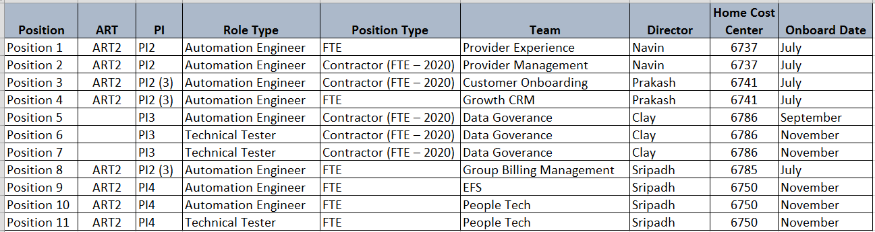
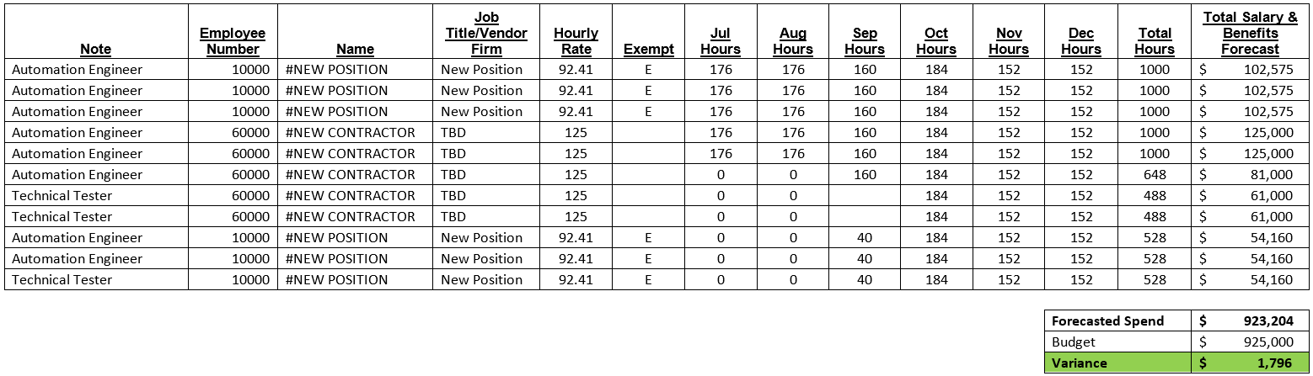
Appendix Resource Funding

Slide 25
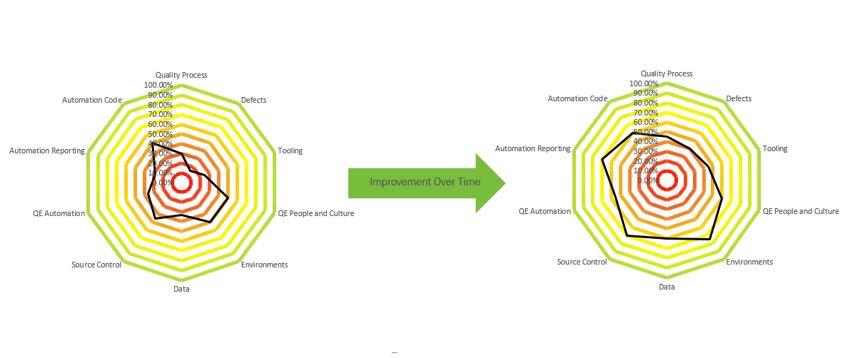
Appendix Questionnaire Sample

Slide 26
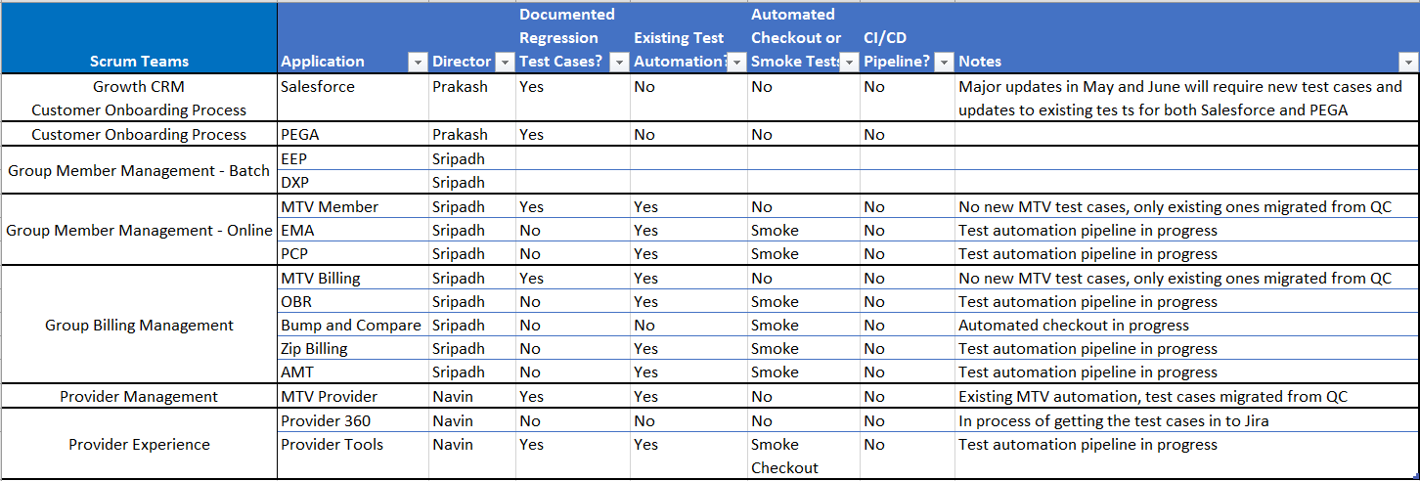
Appendix ART2 Automation Assessment

Slide 27
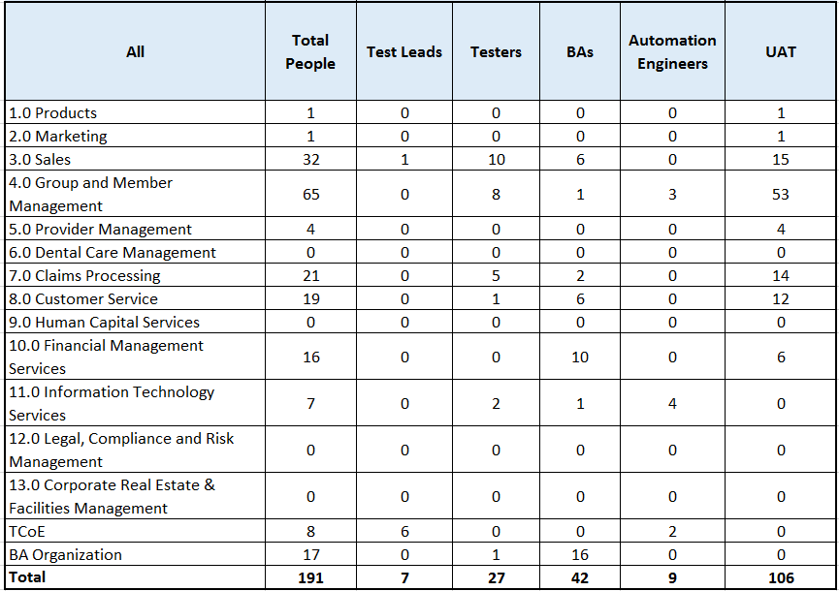
Appendix Tester Coverage Summary
Asks | Decisions

Slide 28
Phase II – Rollout Status
November
December
January
February
March
Asks | Decisions
Test Case Standardization
Quality Metrics
Defect Standardization
QA Tool Kits
Test Management Tool Evaluation
Traceability
QA Roles
Legend
Overall Test Strategy and Framework per SDLC
Complete
Automation Strategy and Best Practices
In Progress
QA Environment Needs
Not Started
Standardized and Scalable Framework
Out of Scope

Slide 29
Phase III – Capability Rollout Status
Phase III Capabilities Being Delivered:
Standardized, repeatable, consistent, best in practice QE processes (Magenic)
Centralized, scalable automation framework (Magenic)
Testing best practice QE principles across the SBDF teams (Magenic)
Cross-trained testing resources able to do manual and automated testing (Delta Center of Practice)
June
July
August
September
October
November
December
Asks | Decisions
ART 1: Standardized, repeatable, consistent, best in practice QE processes
PI3 ART2: Standardized, repeatable, consistent, best in practice QE processes
ART 1: Centralized, scalable automation framework
PI3 ART2: Centralized, scalable automation framework
ART 2: Standardized, repeatable, consistent, best in practice QE processes
New Teams: Standardized, repeatable, consistent, best in practice QE processes
ART 2: Centralized, scalable automation framework
New Teams: Centralized, scalable automation framework
Legend
Testing best practice QE principles across the SBDF teams
Complete
Cross-trained testing resources able to do manual and automated testing
In Progress
Not Started
Out of Scope

Slide 30
Appendix Core Working Group Members
Core Program Team
Debbie Rizzetto – Tech Manager, Quality Management
Chad Ullman – Tech Specialist, Automation
Kevin Fennessy – Tech Manager, Claims Manager
Priscilla Ilan – Tech Manager, DDAZ
Nisheet Verma – Tech Director, App Dev
Navin Prabhu – Tech Director, App Dev
Nitin Jain – Project Manager, EPMO
Brad Shaffer – Business Director, Internal Audit
Baron Stare – Business Director, Operations
Kevin Ward – Business Director, E&B Business Process QE
Asks | Decisions

Slide 31
Appendix Task Teams
Defect Standards Task Team
Leo Liu – Magenic, Test Lead
Parry Pandher – Roll-Out Lead
Henry Lam – Jira Admin & Oversight
Uday Rangaswamy - Dewpoint
Test Case Standards Task Team
Leo Liu – Magenic, Test Lead
Hyacinth Delgado – Roll-Out Lead
Test Leads – Requirements Input
Asks | Decisions
Metrics Task Team
Leo Liu – Magenic, Test Lead
Becky Pauley – Roll-Out Lead
Kevin Ward – Requirements Input
Maggie Pollock, Paul Benda, Nitin Jain, Kristy Frankel – PMO
Automation Task Team
Jeff Xiong – Magenic, Automation Lead
Chad Ullman – Roll-Out Lead
Nisheet Verma – Requirements Input
Navin Prabhu – Requirements Input
Traceability Task Team
Leo Liu – Magenic, Test Lead
Baron Stare – Business Requirements
Duane Nagata – Business Analysis CoP
Kevin Fennessy – IT Claims Testing
Veena Yeole – IT RSO Testing
Artifacts Task Team
Leo Liu – Magenic, Test Lead
Kristy Frankel, Parry Pandher

